Slide 1
Crop Production- Propagation
Preparation and Techniques

Slide 2
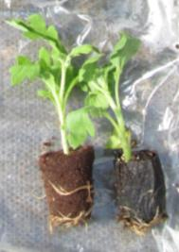
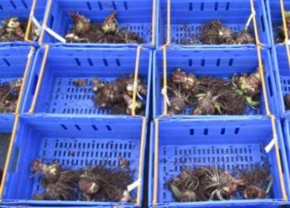
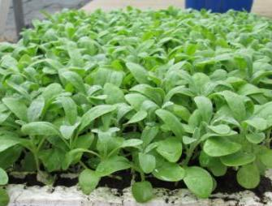
What is Propagation?
A method of producing new plants.
In commercial horticulture it is a specialised sector that includes seed breeders, young plant nurseries and a wide range of suppliers.
Knowing how to propagate or manage young plants is essential for all horticultural businesses.

Slide 3
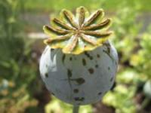
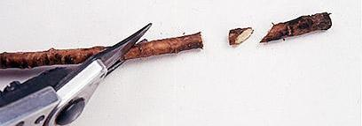
Types of Propagation
Sexual – seed
Pollination of female flowers/flower parts
New plants may vary from parents – not identical
Opportunity to raise new plant cultivars/varieties
Vegetative – using plant parts – not seed
Leaf, stem, root, shoot, bud, tubers, bulbs...
Identical to parent plant
Used to retain specific plant characteristics
www.rhs.org.uk

Slide 4
Propagation Checklist
Healthy plant material/viable seed
Stage of growth
Time of year
Equipment required
Site preparation
Aftercare plan
Selection
Preparation
Establishment

Slide 5
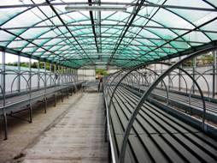
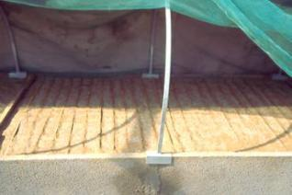
Cultural Requirements
Hygiene
Healthy plant material
Growing medium
Moisture/humidity
Ventilation
Temperature – soil & air
Feeding
www.internationaloliveoil.org
www.internationaloliveoil.org

Slide 6
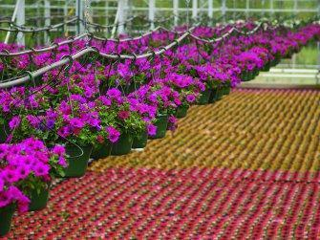
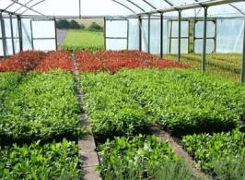
Methods of Propagation
Most common horticultural methods are seed or cuttings
Other methods include grafting, budding, division and micro-propagation.
www.bordnamonahorticulture.ie
www.floraculture.eu

Slide 7
Which method for horticulture crops*?
Seed
Vegetables
Cut flowers
Bedding plants
Grass
Cuttings/Vegetative
Trees
Shrubs
Fruit
http://smgworld.bu.edu
*General guideline there are always exceptions

Slide 8
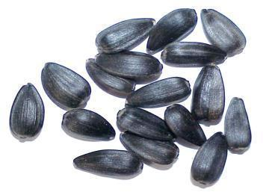
Seed
Wide choice of plant varieties available including heritage var.
Can produce plants with a wide variation in characteristics
May need pre-treatment to break dormancy
Can take longer to produce crops compared to other methods eg bulbs/tubers
http://ed101.bu.edu

Slide 9
Benefits of Seed
Commercial varieties normally available as seed.
Can be purchased for a relatively low cost.
Easy to store and transport
Can collect from own plants
Can be sown directly into soil for crop establishment – using machinery

Slide 10
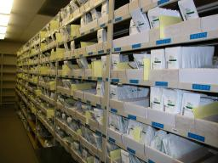
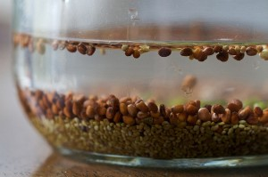
Seed Viability
Viability
Storage period
Temperature
Moisture content
Embryo condition
Tests & Indicators
Visual
Float/sink
Laboratory
https://badger.uvm.edu
http://themicrogardener.com

Slide 11
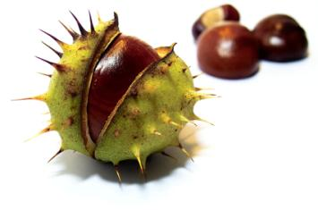
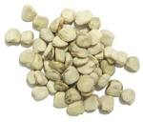
Seed Dormancy
Dormancy is a mechanism in the seed which prevents immediate germination but regulates time & conditions.
Types of Mechanisms
Hard coat – blocks water & air
Immature embryo
Chemical inhibitors
totalhealthenhance.com

Slide 12
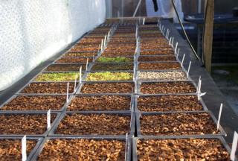
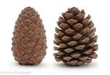
Treatments to Break Dormancy
Stratification – 0C-5C ‘chilling’ length varies on species
Scarification – hard seed coat is ‘nicked’ to let water & air in
Soaking/flushing of inhibitor
Chemical stimulants – hormones/smoke water
Heat – open seed coat
http://lodgelanenursery.blogspot.co.uk

Slide 13
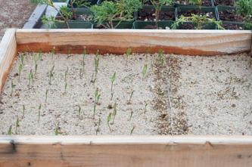
Dormancy Treatments
www.victoria-adventure.org
http://bonsaitonight.com
http://themicrogardener.com

Slide 14
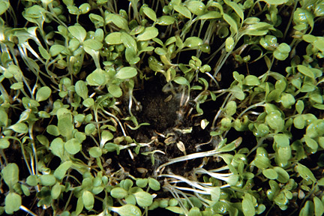
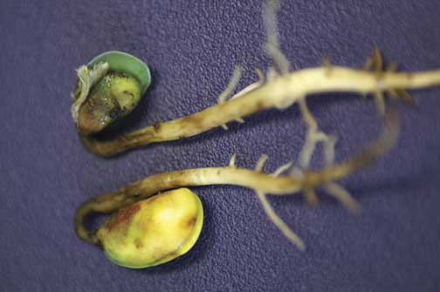
Damping Off
Fungi/bacteria pathogens -Pythium, Fusarium, Rhizoctonia
Seedlings fail to germinate or collapse shortly afterwards
Soft/wet rot
Prevent by lowering sowing density, reduce watering/humidity and fungicide treatments.
www.rhs.org.uk
www.ipm.iastate.edu

Slide 15
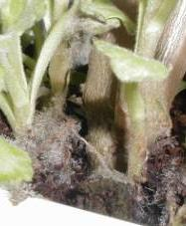
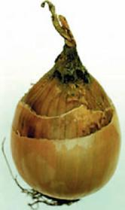
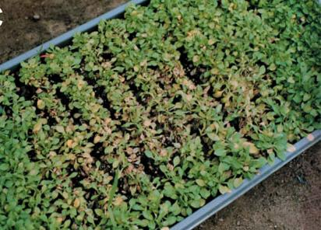
Botrytis
Grey Mould
Leaf spots that spread over leaf area
Grey fuzzy growth – not always present
Plants shrivel and die
Prevent with good ventilation, hygiene and fungicides
www.daff.qld.gov.au
www.chrysanthemums.info
http://msue.anr.msu.edu

Slide 16
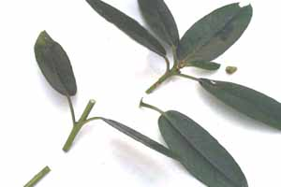
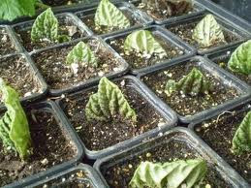
Cuttings
Most common form of vegetative propagation
Nursery ‘stock plants’
Leaf, stem, root, shoot
Hardwood, softwood, semi-hardwood
Specific techniques used for different species
www.donaldhyatt.com
http://planetbegonia.blogspot.co.uk

Slide 17
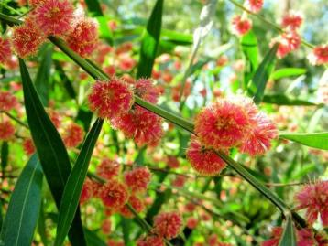
Benefits of Cuttings
Young plants are identical to parent plant.
Quicker to produce new plants than seed.
Stronger plants.
Only one plant needed.
May be the only option.
www.abc.net.au

Slide 18
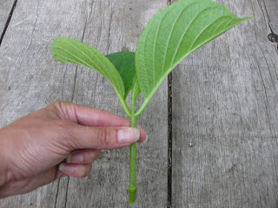
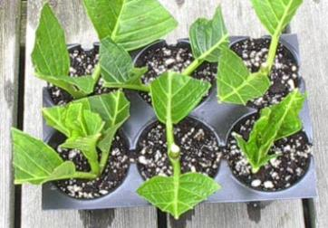
Softwood Cuttings
Select new growth and cut into 5-10cm lengths.
Using a sharp knife make a clean slanting cut below/between nodes.
Reduce leaf area by 2/3 to prevent water loss
Firm into potting compost – 50:50 peat & perlite
Mist watering
Place in a warm and bright area
http://goodbetternest.blogspot.co.uk
www.nantuckethydrangea.com

Slide 19
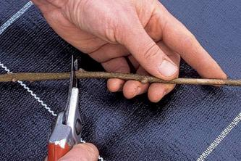
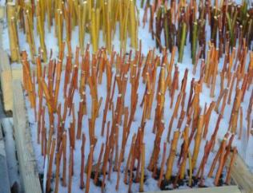
Hardwood Cuttings
Autumn/winter - deciduous
Remove soft tips and use mature growth
Cut into 15-30cm lengths
Below a bud cut straight across
Plant outdoors – trays/trench with 2/3 of the cutting below soil level
Remove next autumn
www.rhs.org.uk
http://mikesbackyardnursery.com

Slide 20
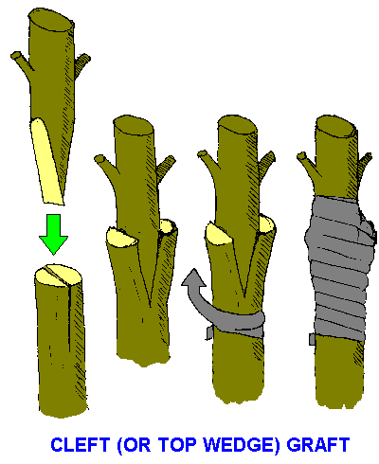
Grafting
A method of propagation where the scion of one plant and the rootstock of another are artificially united.
Plants normally from the same genus or family.
Often used in fruit trees before sap begins to rise ie early Spring.
Used where seed propagation is unsuitable.
http://anpsa.org.au

Slide 21
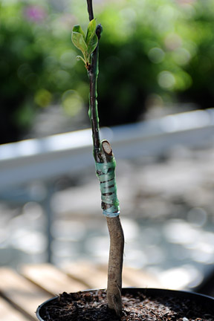
Benefits of Grafting
Combine the fruiting or flowering qualities of one variety with the vigour of another.
Quicker to produce a fruiting variety rather than waiting for seed to grow.
Can be used to reduce vigour of fruit trees.
www.rhs.org.uk

Slide 22
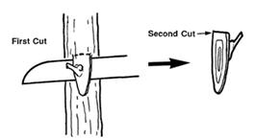
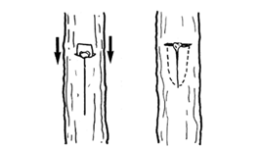
Budding
A form of grafting that uses a single bud instead of a shoot/stem.
Usually performed on fruit trees during the growing season.
Match plants of the same family or genus.
Good contact between both cambia essential.
www.ces.ncsu.edu

Slide 23
Benefits of Budding
Small cuts to the tree minimises damage & risk of infection.
Weak cultivars can be grafted on to more vigorous plants.
Less labour intensive.
Shorten production time.
www.appleman.ca

Slide 24
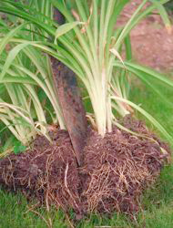
Division
Mature plants are divided to create ‘new’ plants
Used for some perennials, bulbous and herbaceous plants
Root/rhizome included
Require less skill & aftercare management than other forms of propagation

Slide 25
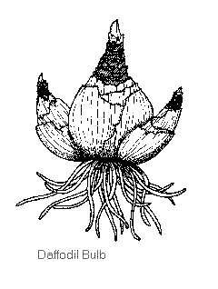
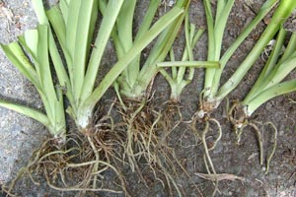
Benefits of Division
Quick method of establishing new plants eg daffodils
Low cost – ‘free plants’
May be the most feasible propagation method for specific plants
http://gardening.yardener.com
www.tekura.school.nz

Slide 26
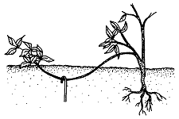
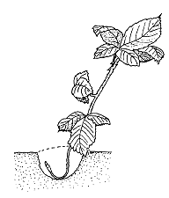
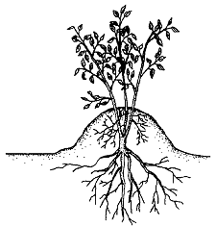
Layering
www.ces.ncsu.edu
A form of division where the ‘new’ plant is not separated from the parent plant until it has rooted.
Can be used to root shrub branches eg Cornus, Spirea, Hydrangea, Cotoneaster
Mature and strong plants can be produced quickly
Several types – tip, air, simple, mounding

Slide 27
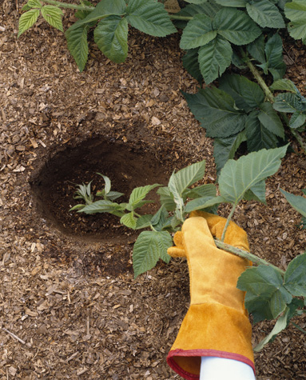
Benefits of Layering
High success rate with correct species
A large plant is produced in a short timeframe
Minimal labour
Low cost
www.dkimages.com

Slide 28
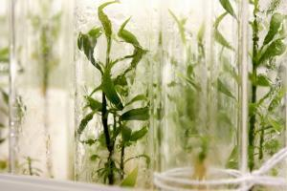
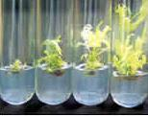
Micro-propagation
Plant tissue is grown in nutrient dishes under laboratory conditions
Tissue with cell division function used – growing tips
A high volume of small plants can be produced in a short space of time
High production cost
http://manoa.hawaii.edu
http://dbtmicropropagation.nic.in

Slide 29
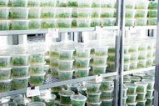
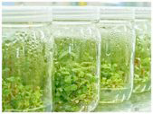
Benefits of Micro-propagation
Identical new plants – harvesting dates, size, growth, colour...
Very high hygiene standards – disease free plants
Large number of plants produced from a small volume of tissue
Often used for food crops in developing countries

Slide 30
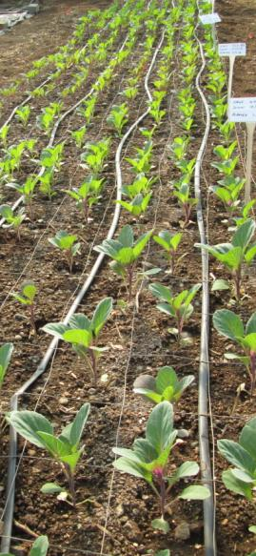
Aftercare
Label – name & date
Light, temperature, moisture & ventilation
Monitor watering – especially seed post germination
Discard diseased or dead plants
Grade cuttings/transplants according to size – uniformity of growth
Protect from slugs, snails, birds etc.
Keep weed free
Hardening off

Slide 31
Further Reading
Dirr, M. & Heuser, C. 2009. Reference Manual of Woody Plant Propagation, Timber Press
Hartmann, Kester, Davies & Geneve, 2010. Plant Propagation: Principles and Practice, Prentice Hall
Toogood, A. 2006. RHS Propagating Plants. Dorling Kindersley.

Slide 32
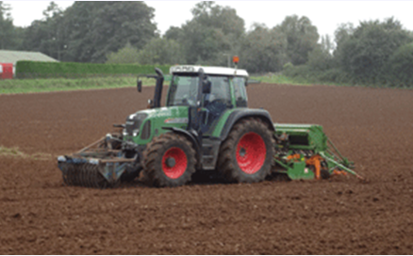
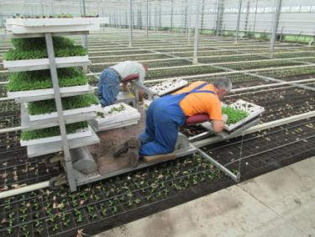
Seed Bed Preparation
Field, nursery & landscape

Slide 33
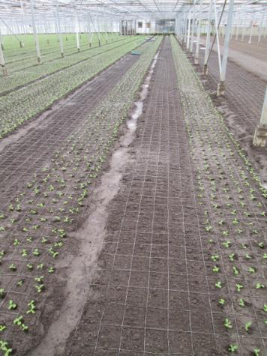
Why Cultivate Soil?
To create a fine tilth (fine particles) for improved seed/transplant establishment
Break-up soil compaction
Bury weeds
Enable soil amendments to be incorporated
Aerate the soil

Slide 34
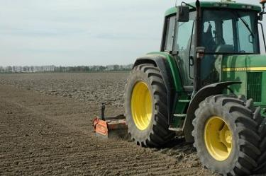
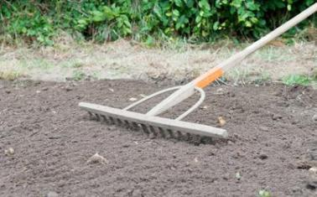
Seedbed characteristics
Even surface
Weed free
Uniform firmness
Adequate soil moisture
www.aardappelpagina.nl
www.diynetwork.com

Slide 35
Timing of Preparations
Prior to seeding/planting
Weather permitting
www.teagasc.ie/newsletters

Slide 36
Seedbed Checklist
pH & nutrient content – amendments required?
Vegetation cover - pre-treatment required?
Is soil free draining?
What is the soil temperature?
Notes:
Handout soil texture chart at this stage
12 different soil types

Slide 37
When not to cultivate soil
www.abc.net.au
www.bio.anl.gov/images
Frozen
Waterlogged
Notes:
Handout soil texture chart at this stage

Slide 38
Depth of Seedbed
Will depend on soil type, compactness of soil and crop requirements.
Shallow –less than 20cm
rotovater, harrow, plough
Deep - below 20cm
deep plough, ripper/subsoiler
www.tractorsupply.com
http://forthoodreveg.tamu.edu

Slide 39
Cultivation Issues - Hard Pan
Below surface soil compaction – created by machinery, people or livestock.
Can also be caused by repeated cultivation depth.
Will have a negative effect on crop growth, yield and quality.
Solutions to soil compaction are:
Sub soiling
Varying cultivation depths
Management techniques; ie prevention

Slide 40
Cultivation Methods - Plough
Plough – The only implement that inverts soil bringing fresh soil to the surface.
Normally used in field production.
Used to bury perennial weeds & surface debris.
Generally cultivates to a depth of approximately 20cm but can be used deeper.
Often used where ground has been out of cultivation for sometime.
Usually followed by harrow & roller to prepare a seed bed.
http://news.bbc.co.uk
www.indiainternationalyellowpages.com
http://www.youtube.com/watch?v=Ljm-a-OItJw
VIDEO

Slide 41
Cultivation Methods - Rotovator
Rotovator (Rotary cultivator) -Breaks up soil to allow aeration.
Widely used in horticulture instead of ploughing.
Walk behind, self propelled or tractor mounted.
Can be used to a depth of approximately 20cm.
L shaped/finger blades rotate soil in direction of travel.
Soil is shattered against a rear shield to produce a fine tilth.
Advantage: quicker to make a seedbed and come in a range of widths 80cm-3m .
Disadvantage: does not bury stones or debris.
www.usedhorticulturalmachinery.co.uk

Slide 42
Cultivation Methods - Roller
Roller - Firms soil surface and buries large stones/clods.
Can be used after seeding.
Often incorporated into other implements.
Various Types
Smooth
Cambridge
Tubed
http://farm.autotrader.co.uk
www.blec.co.uk

Slide 43
Cultivation Methods - Seeders
Types:
Pedestrian
Mounted Hopper
Precision seed drills
www.southernplant.co.uk
VIDEO
http://www.youtube.com/watch?v=0H2YkvfU2Ys
www.usedhorticulturalmachinery.co.uk

Slide 44
Cultivation Methods - Transplanter
Used for planting young plants.
Adjustable row spacing.
More common in field production for vegetable crops eg cabbage.
www.italianfarmmachinery.com

Slide 45
Other Equipment
www.pjcallanltd.com
www.pjcallanltd.com
www.pjcallanltd.com
Bed former
Ridger
Stone burier
Bulb crops –
Daffodil
Onion
Veg & flower crops–
Potato
Peony
Landscape –
Lawns

Slide 46
Variety Selection

Slide 47
Common Crop Varieties
Apple
‘Bramley’s Seedling’
‘Granny Smith’
‘Discovery’
Cut Flower Lily
‘Pink Bouquet’
‘Casa Blanca’
‘Sorbonne’
Vegetables
Carrot ‘Nairobi’
Lettuce ‘Lollo Rosso’
Celery ‘Victoria’
www.reynolds-cs.com
www.dreamstime.com

Slide 48
What is a Variety?
Family
Genus
Species
Variety
A variety is a plant that differs from others of the same species with minor but permanent characteristics - occurs naturally.
Example: Fagus sylvatica var. heterophylla
A cultivar is a plant raised or selected in cultivation that retains distinct, uniform characteristics when propagated by appropriate means.
Example: Fagus sylvatica var. heterophylla 'Asplenifolia‘ (Fernleaf beech)

Slide 49
Why use different varieties?
Extend harvesting using early and late varieties
Improve disease resistance of crop
Seasonal performance – cold hardy/heat tolerant
Meet customer expectations eg cut flowers in various colours
Different crop varieties for different markets eg eating & cooking apples
Length of production time – shorter growing period always commercially attractive
www.sunfarm.com

Slide 50
What are F1 Hybrids?
A first generation (F1) cross.
Parents with different but stable characteristics (F8-12) eg white & red flowers.
Cross dominant & recessive genes.
Genetically uniform result – pink flowers.
A second generation cross (F2) or self pollination will give a non uniform result eg 50% pink, 25% red, 25% white flowers.
www.eplantscience.com

Slide 51
Why use F1 Hybrids?
Stable variety characteristics
Uniform crop quality, size, colour, harvesting
Improve overall crop performance eg disease resistance
Hybrid vigour
www.eplantscience.com

Slide 52
Thank you

